Slide 1
Wireless Power Transmission via Strongly Coupled Magnetic Resonance (SCMR) for Embedded Systems
Robert St. Denis & Waqas Haque
EEC284 Project Presentation

Slide 2
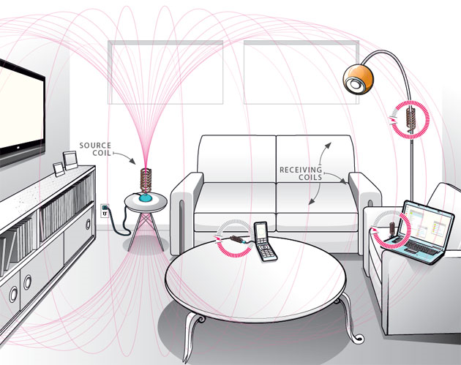
Introduction & Motivation
Mobile devices become static during battery charging
Using wires to power basic appliances works, but we can do better: No physical contact between source and load
Applications in Wearable and Implantable Devices

Slide 3
Basic Idea
4 Coils used: source coil (L1), TX resonating coil (L2), RX resonating coil (L3) and load coil (L4)
L1 is provided AC power at the resonating frequency of L2 and L3.
L2 and L3 capacitance and inductance is modelled to resonate at the same operating frequency.
Mutual inductance between L1 and L2 causes L2 to resonate and create a large magnetic field

Slide 4
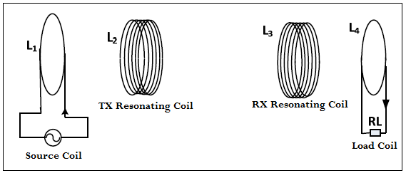
Basic Idea
Mutual inductance between L3 and L4 to drive the load
By placing L3 within the magnetic field, a resonant circuit is created and power is transferred to L3

Slide 5
Previous Work
Our work is based on the research done by a group from MIT [1]
They were able to transfer 60 watts with an efficiency of approximately 40% at a distance of about 2m. High power input
They used large coils with a radius of 30cm and 5 turns each with a wire cross section of 3mm
Our goal is to scale the design for low power embedded systems devices

Slide 6
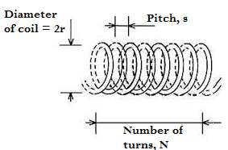
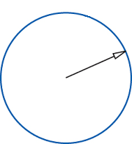
Mathematical Model: Calculating Resonance Frequencies and Quality factor
Known parameters of a coil:
Cross sectional radius of wire, r_{c}
Radius of coil, r
Number of turns, N
Pitch, s
To be calculated:
Capacitance, C
Inductance, L
Resonant Frequency, f_{o}
Loss (Impedance), Г
Quality factor, Q
r_{c}
Wire Cross Section

Slide 7
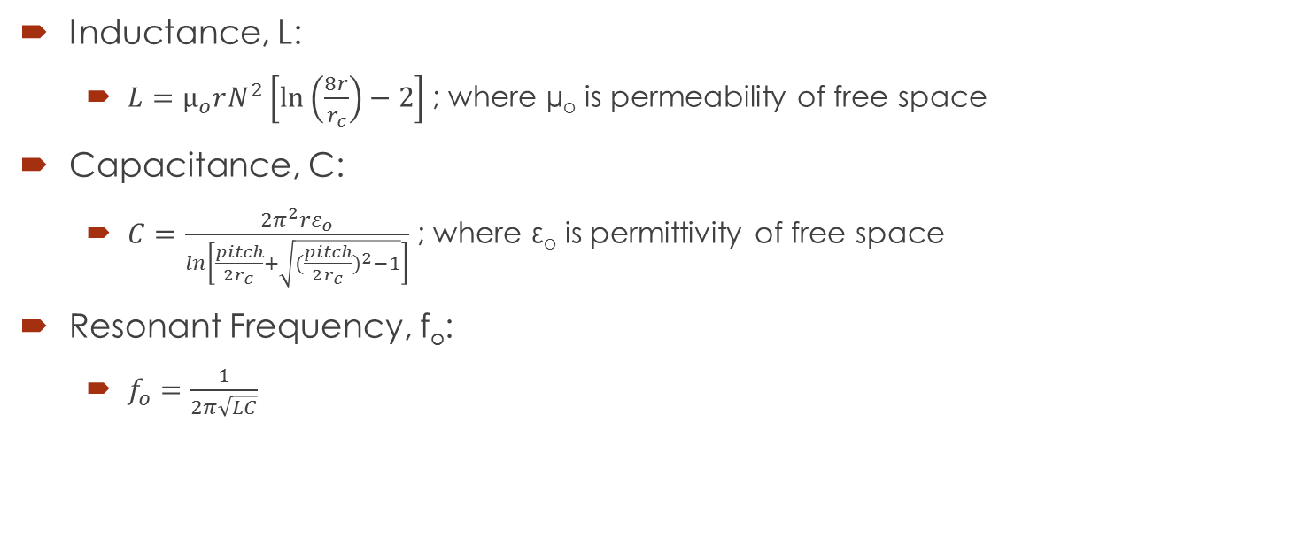
Mathematical Model: Calculating Resonance Frequencies and Quality factor
Inductance, L:
$L=µ_{o}rN^{2}\left[\ln\left(\frac{8r}{r_{c}}\right)−2\right]$; where µ_{o} is permeability of free space
Capacitance, C:
$C=\frac{2π^{2}rε_{o}}{ln\left[\frac{pitch}{2r_{c}}+\sqrt{{(\frac{pitch}{2r_{c}})}^{2}−1}\right]}$ ; where ε_{o} is permittivity of free space
Resonant Frequency, f_{o}:
$f_{o}=\frac{1}{2π\sqrt{LC}}$

Slide 8
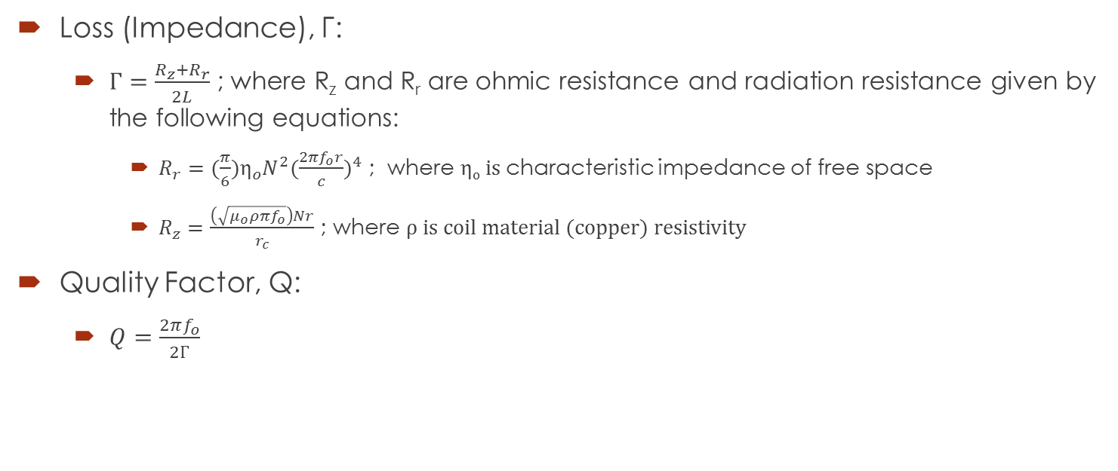
Mathematical Model: Calculating Resonance Frequencies and Quality factor
Loss (Impedance), Г:
$Г=\frac{R_{z}+R_{r}}{2L}$ ; where R_{z} and R_{r} are ohmic resistance and radiation resistance given by the following equations:
$R_{r}=(\frac{π}{6})η_{o}N^{2}{(\frac{2πf_{o}r}{c})}^{4}$ ; where η_{o} is characteristic impedance of free space
$R_{z}=\frac{\left(\sqrt{μ_{o}ρπf_{o}}\right)Nr}{r_{c}}$ ; where ρ is coil material (copper) resistivity
Quality Factor, Q:
$Q=\frac{2πf_{o}}{2Г}$

Slide 9
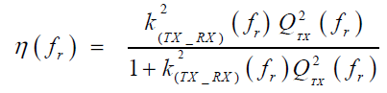
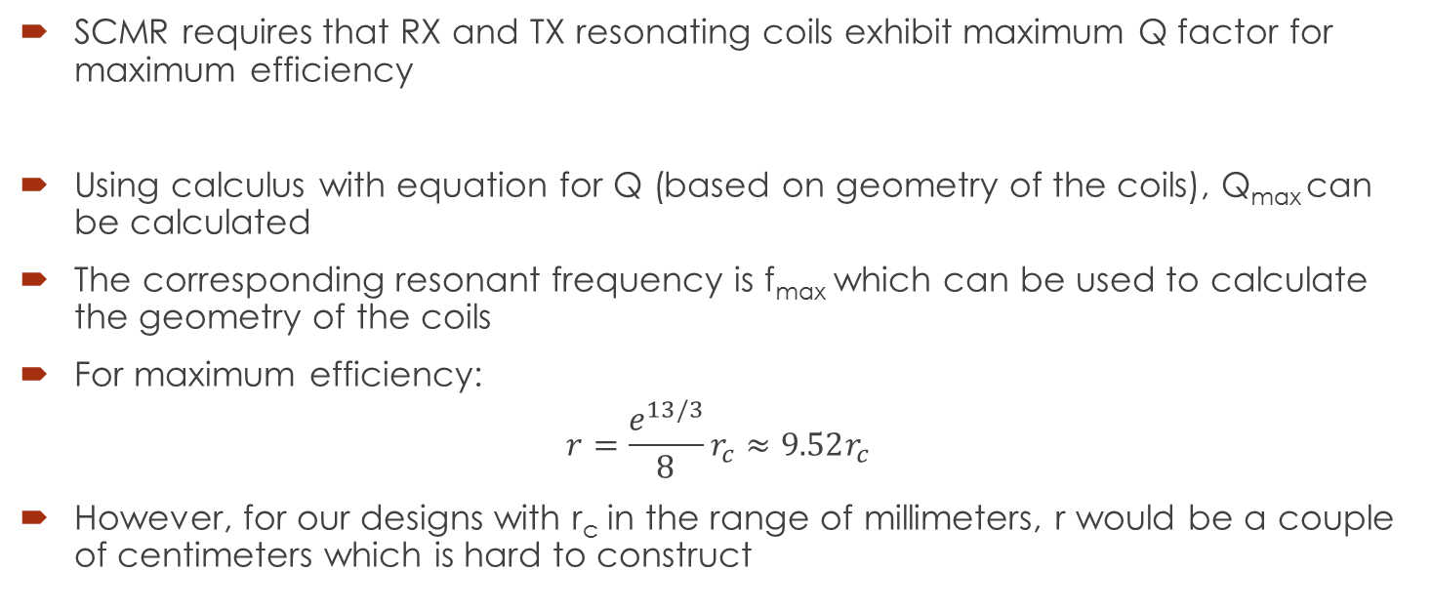
Mathematical Model: Optimal Resonance Frequency and Quality factor
SCMR requires that RX and TX resonating coils exhibit maximum Q factor for maximum efficiency
Using calculus with equation for Q (based on geometry of the coils), Q_{max} can be calculated
The corresponding resonant frequency is f_{max} which can be used to calculate the geometry of the coils
For maximum efficiency:
$$r=\frac{e^{13/3}}{8}r_{c}≈9.52r_{c}$$
However, for our designs with r_{c} in the range of millimeters, r would be a couple of centimeters which is hard to construct

Slide 10
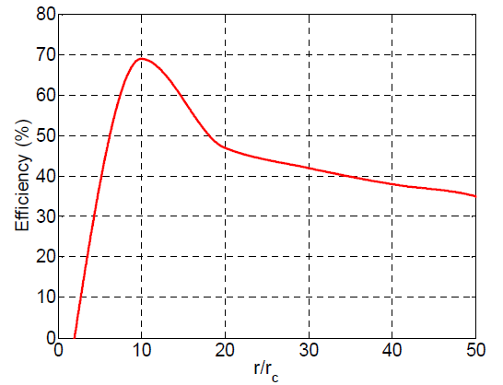
Mathematical Model: Optimal Resonance Frequency and Quality factor

Slide 11
MATLAB Model: Calculating Resonance Frequencies and Quality factor
Cross sectional radius of wire, r
Radius of coil, r
Number of turns, N
Pitch, s
Inductance, L
Resonant Frequency, f_{o}
Capacitance, C
Quality Factor, Q
Ohmic Resistance, R_{z}
Loss (Impedance), Г
Radiation Resistance, R_{r}

Slide 12
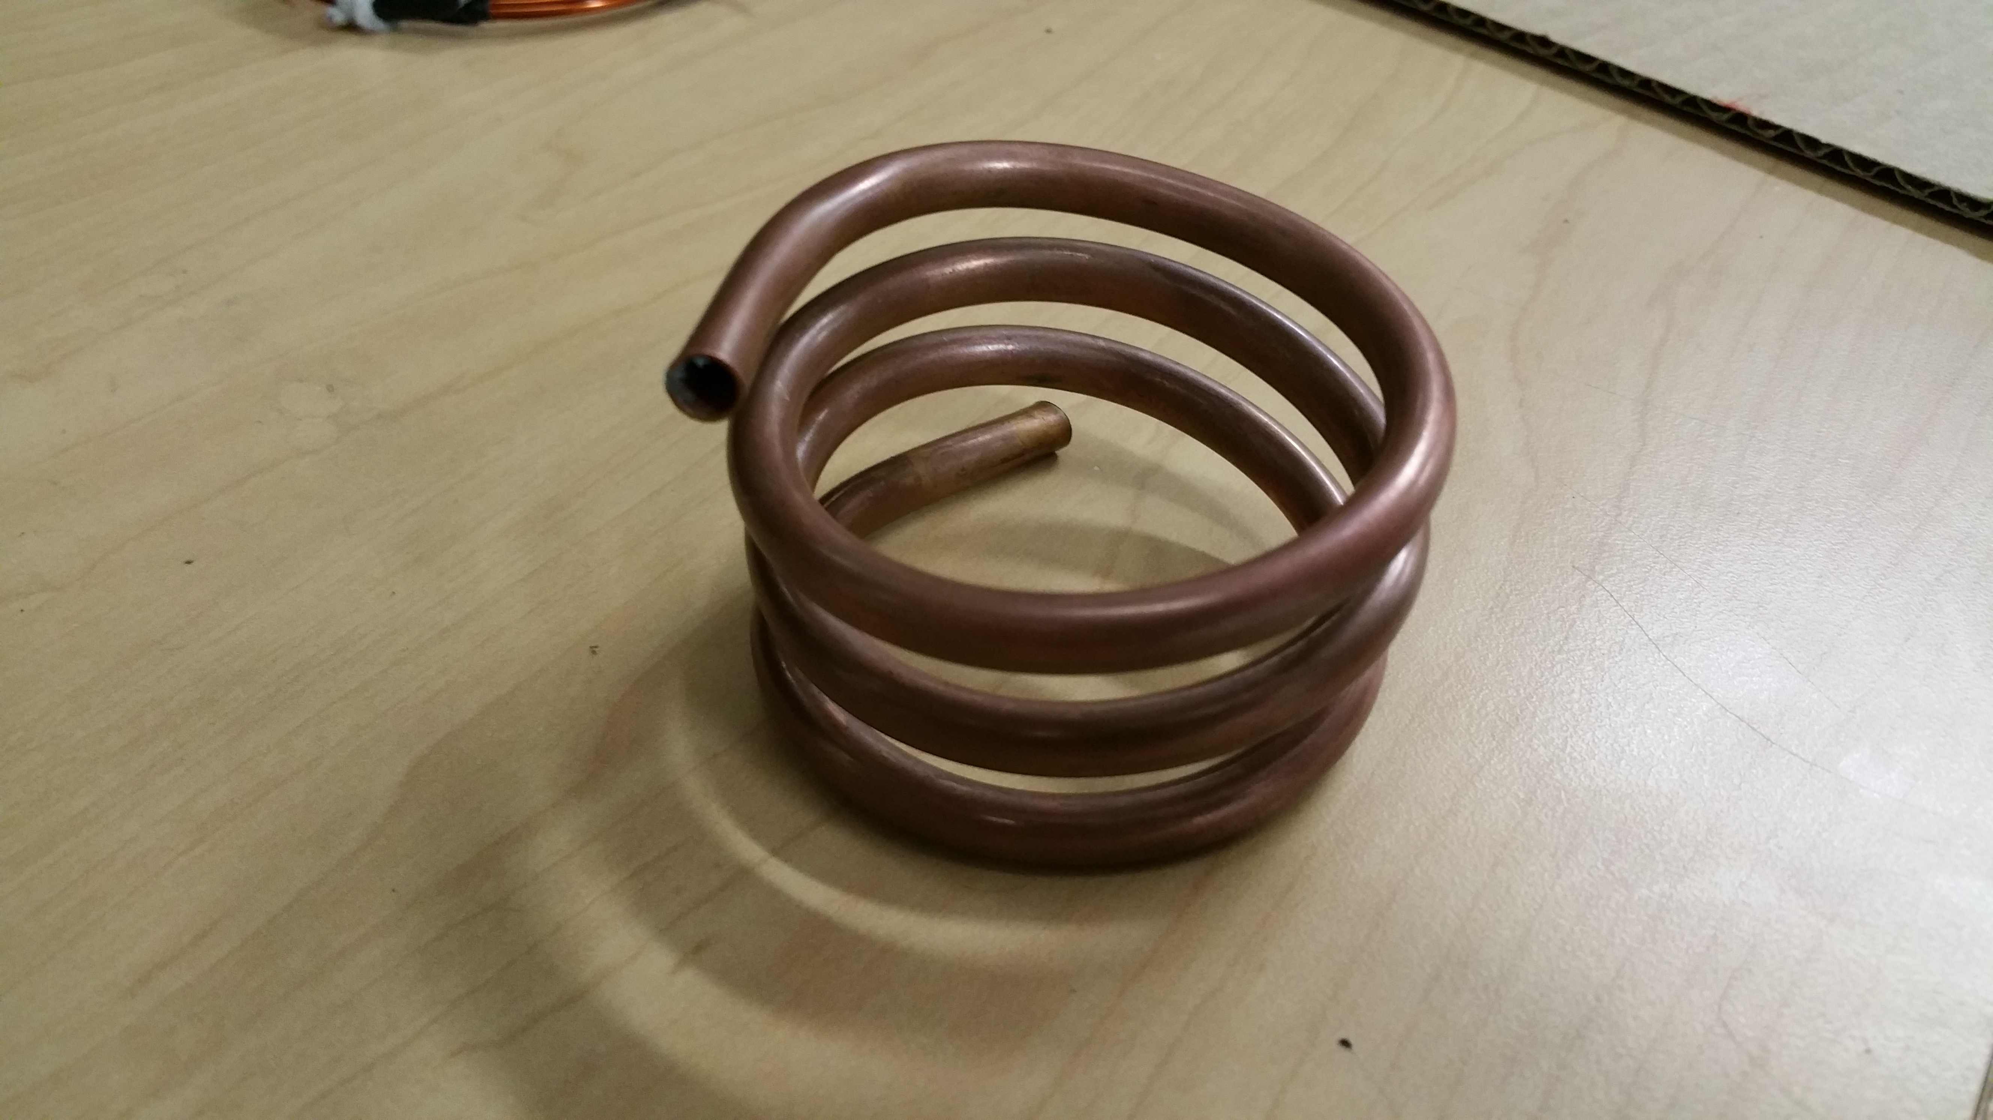
Results: Copper Tube (r_{c}=2.59mm)
Cross-sectional radius = 2.59470 mm (4 AWG) Loop radius = 1.90500 cm (0.750000 in) Loop diameter = 3.81000 cm (1.500001 in) Pitch = 0.80000 cm (0.314961 in) N = 5.25 turns Length of wire/tube = 62.840 cm (2.061670 ft) ~~~~~~~~~~~~~~~~~~~~ Estimated f0 = 74.534254 MHz Estimated wavelength = 4.022312 m Estimated L = 1.367826 uH Estimated C = 3.333478 pF External Capacitor = N/A Estimated Q = 8025.117251 Gamma (Loss) = 29177.924374 Radiation Resistance = 0.036998 Ohmic Resistance = 0.042823
Measured Resonant Frequency ≃ 16MHz

Slide 13
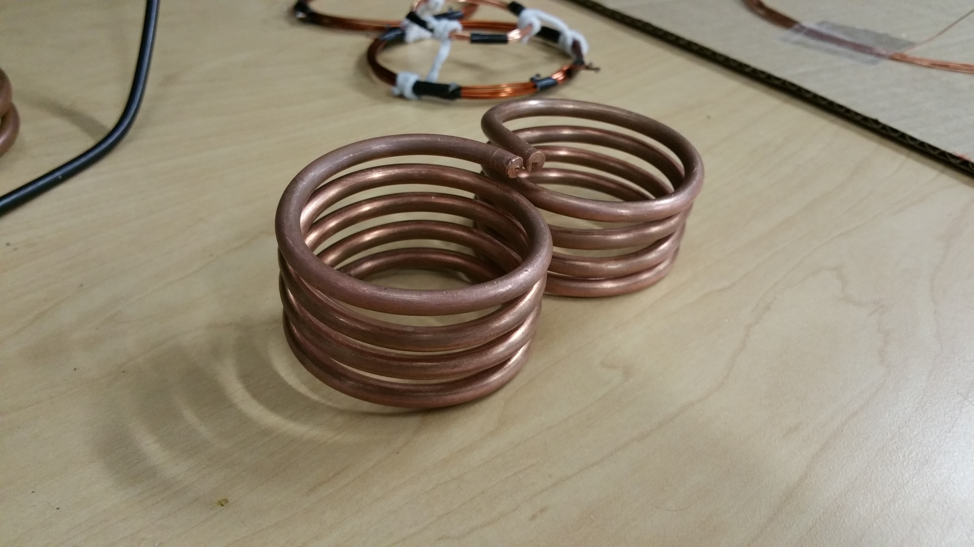
Results: Solid Copper Wire (r_{c}=2.59mm)
Cross-sectional radius = 2.59470 mm (4 AWG) Loop radius = 1.90500 cm (0.750000 in) Loop diameter = 3.81000 cm (1.500001 in) Pitch = 0.80000 cm (0.314961 in) N = 5.25 turns Length of wire/tube = 62.840 cm (2.061670 ft) ~~~~~~~~~~~~~~~~~~~~ Estimated f0 = 74.534254 MHz Estimated wavelength = 4.022312 m Estimated L = 1.367826 uH Estimated C = 3.333478 pF External Capacitor = N/A Estimated Q = 8025.117251 Gamma (Loss) = 29177.924374 Radiation Resistance = 0.036998 Ohmic Resistance = 0.042823
Measured Resonance Frequency ≃ 14MHz

Slide 14
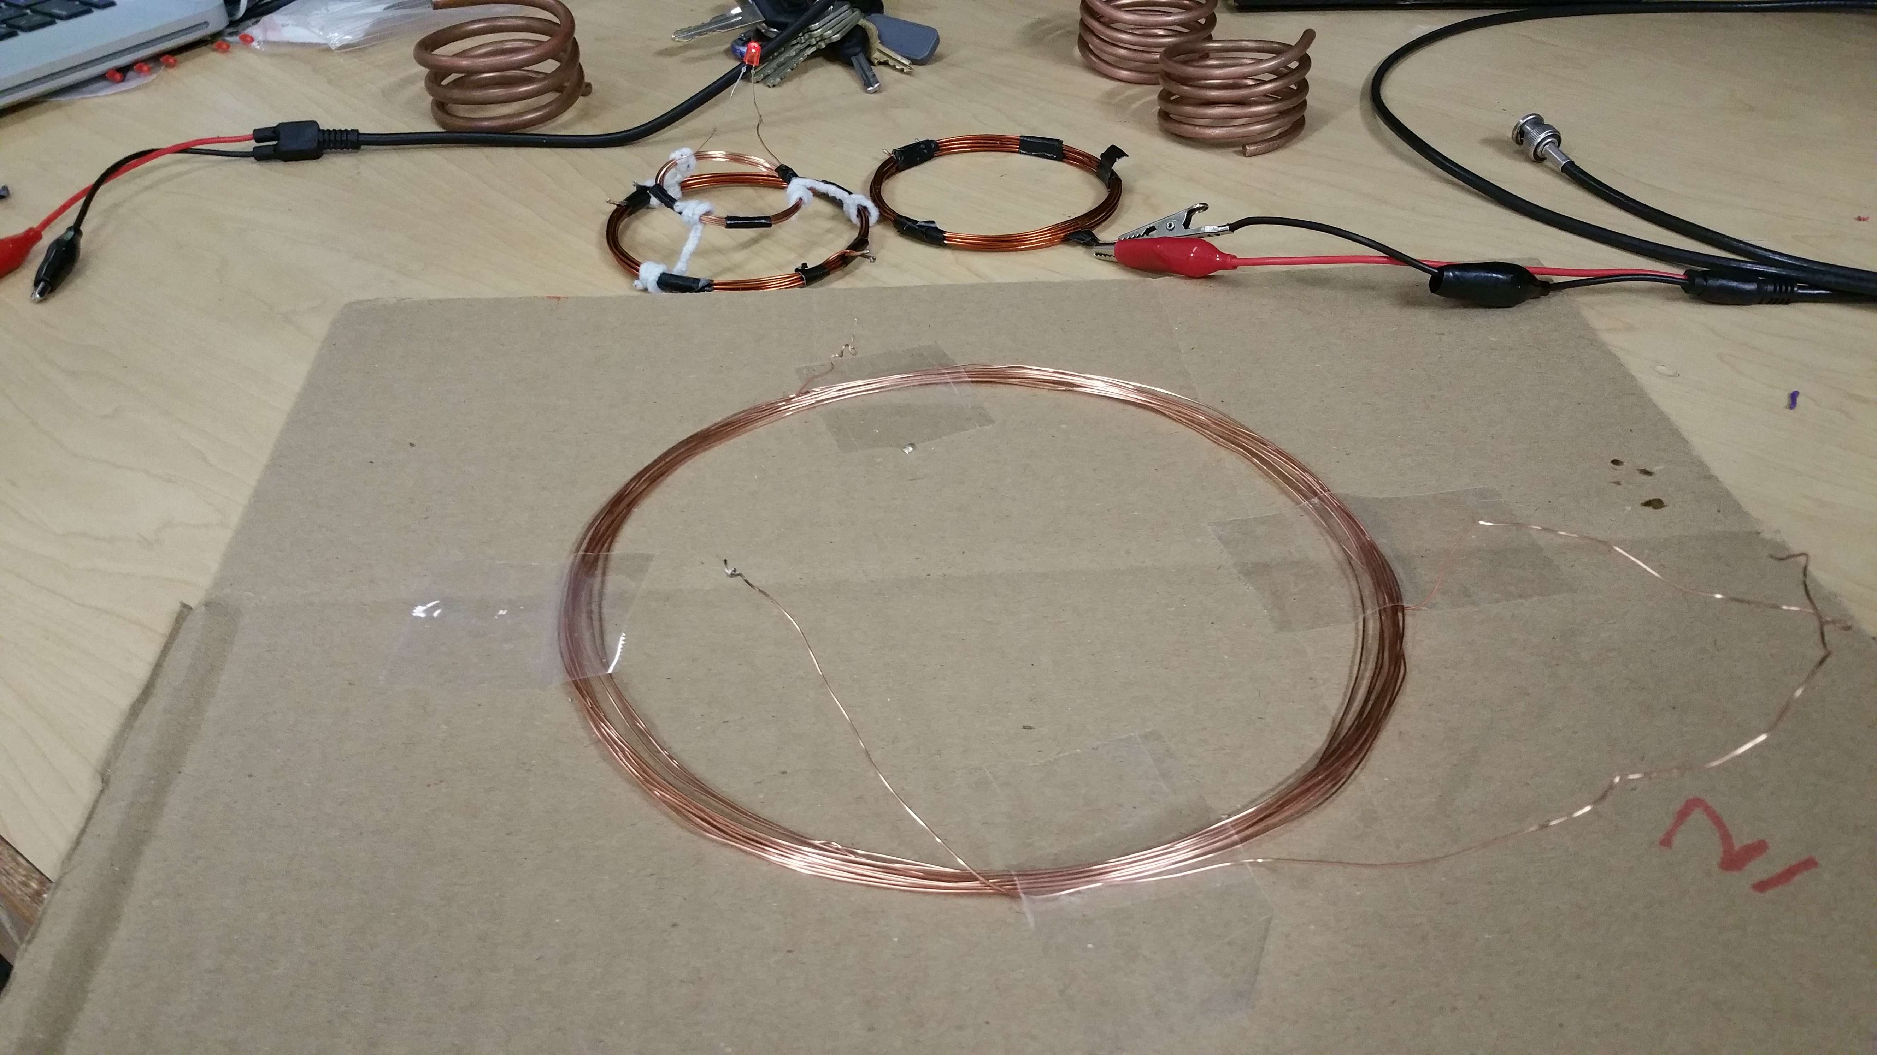
Results: Solid Copper Wire (r_{c}=0.31mm )
Cross-sectional radius = 0.32190 mm (22 AWG) Loop radius = 10.00000 cm (3.937010 in) Loop diameter = 20.00000 cm (7.874020 in) Pitch = 0.06519 cm (0.025663 in) N = 10.00 turns Length of wire/tube = 628.319 cm (20.614126 ft) ~~~~~~~~~~~~~~~~~~~~ Estimated f0 = 1.769517 MHz Estimated wavelength = 169.424724 m Estimated L = 73.112664 uH Estimated C = 110.646574 pF External Capacitor = N/A Estimated Q = 1528.602081 Gamma (Loss) = 3636.723367 Radiation Resistance = 0.000002 Ohmic Resistance = 0.531779
Measured Resonant Frequency = 1.71 MHz

Slide 15
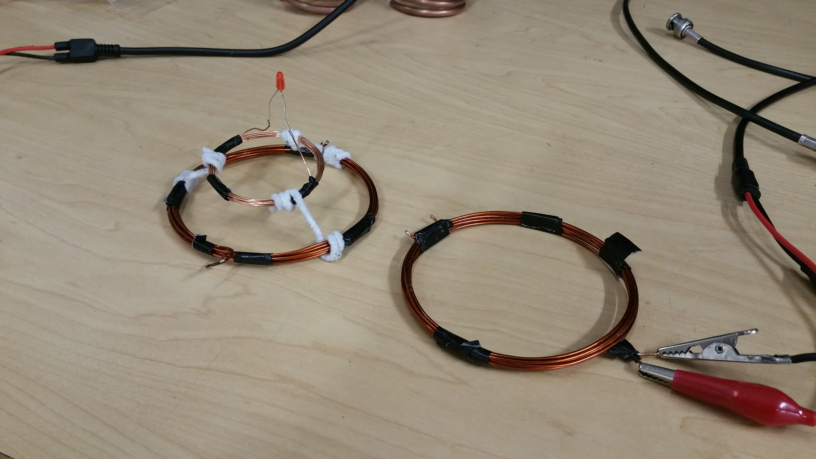
Results: Solid Copper Wire (r_{c}=0.57mm )
Cross-sectional radius = 0.57477 mm (17 AWG) Loop radius = 4.12750 cm (1.625001 in) Loop diameter = 8.25500 cm (3.250002 in) Pitch = 0.12070 cm (0.047520 in) N = 7.00 turns Length of wire/tube = 181.537 cm (5.955936 ft) ~~~~~~~~~~~~~~~~~~~~ Estimated f0 = 9.997383 MHz Estimated wavelength = 29.987848 m Estimated L = 11.064472 uH Estimated C = 22.905348 pF External Capacitor = N/A Estimated Q = 3397.202663 Gamma (Loss) = 9245.166713 Radiation Resistance = 0.000052 Ohmic Resistance = 0.204533
Measured Resonance Frequency = 10.2MHz
25Vpp input – 6Vpp output at 2mA

Slide 16
Challenges
Copper tubes used initially. Mathematical model would not comply with experimental results. Solid copper wires used instead
Optimal geometry hard to construct. Non-optimal design adopted
Resonant frequencies extremely sensitive to variations in coil geometry
High power input circuit for source coil. Desired currents in the range of 1A-3A. High power devices are expensive. Our attempt at constructing simple high frequency, high power input circuits was unsuccessful. Shortage of time. Function generators used instead

Slide 17
Challenges Cont’d: Effects of Humidity[3]

Slide 18
Conclusion and Future work
Our MATLAB model gives a very good estimate (<10% error) of the resonant frequency for a given coil for wireless power transfer
Our demo shows power transfer at resonant frequencies for distances up to 10 centimeters
Larger distances possible with high power input (high current) for source coil. Colpit oscillators can be used
Precise coil design for accurate and consistent output
Resonant frequency matching and impedance matching with r = 9.52r_{c} for higher efficiency
Wi-Fi power, analogous to Wireless internet
WiTricity and their products
Wireless cell phone charger
Electric vehicle battery charger

Slide 19
Acknowledgements
Michael Sitclaru for his design suggestions
Soheil Ghiasi for allowing us the opportunity
Raj Amirtharajah for encouragement

Slide 20
References
[1] A. Kurs, A. Karalis, R. Moffatt, J. D. Joannopoulos, P. Fisher, and M. Soljacic, “Wireless Energy Transfer via Strongly Coupled Magnetic Resonances,” Science 317, 83 (2007)
[2] Jalali Mazlouman, S.; Mahanfar, A.; Kaminska, B., "Mid-range wireless energy transfer using inductive resonance for wireless sensors," Computer Design, 2009. ICCD 2009. IEEE International Conference on , vol., no., pp.517,522, 4-7 Oct. 2009
[3] Jonah, Olutola, "Optimization of Wireless Power Transfer via Magnetic Resonance in Different Media" (2013). FIU Electronic Theses and Dissertations. Paper 876.
[4] R. Lundin "A Handbook formula for the inductance of a single-layer circular coil", Proc. IEEE, vol. 73, no. 9, pp.1428 -1429 1985

Slide 21
Thank you for Listening…
Questions?

